Slide 1

File and Printer sharing in Windows NT Environment
NATIONAL INSTITUTE OF ELECTRONICS AND INFORMATION TECHNOLOGY
Birla Farms, Bada Phull, Ropar
NIELIT ‘O’-Level
IT Tools and Network basics

Slide 2
Formulas Functions and Charts

Slide 3
Index
Formulas
Creating and editing formulas
Operators in formulas
Order of operation
Auto filling formulas
Functions
What are functions?
Functions Syntax
Inserting functions
Basic Functions – Sum, Count, MAX, MIN, Average, If
Relative and Absolute Reference
Database Functions- DSUM, DMAX, DMIN, DCOUNT, DCOUNTA
Charts
Introduction
Basic types of charts – Column, Bar, Pie, Line
Creating charts
Chart elements
Editing charts
Exporting as image

Slide 4
Formulas

Slide 5
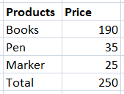
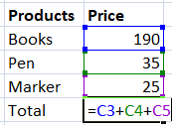
Formulas
In a spreadsheet often the contents of one cell depend on the contents of other cells. For example in a list of item prices, the total depends on each individual item price.
To handle this situation, we use a third type of data: the formula. Formulas are equations using numbers and variables to get a result. In a spreadsheet, the variables are cell locations that hold the data needed for the equation to be completed. Using formulas we can write the total in the previous example as =C3+C4+C5. When you type the formula and press enter the result again will be 30. Νow every time we update the value of one of the items, the total is dynamically calculated.

Slide 6
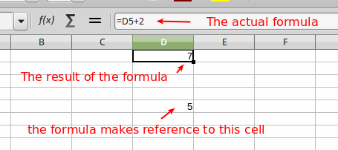
Formulas
Creating and editing formulas
To enter a formula, type directly the formula into the cell or into the input line of the formula bar. A formula must always begin with an = symbol. When you finish typing the formula press the Enter key.

Slide 7
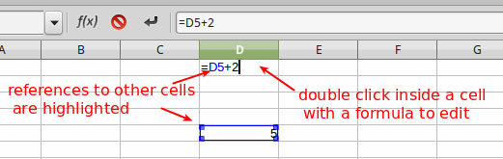
Formulas
Creating and editing formulas
The cell containing the formula normally displays the result of the formula. To display and edit the actual formula double click inside the cell or go to the input line.
When a formula is in edit mode, references to other cells are highlighted.
To exit formula edit mode and display the result or cancel the changes one has made to the formula press the ESCAPE key.

Slide 8
Formulas
Using point and click
When in formula edit mode, instead of manually typing a cell reference, one can just click on a cell and the cell's reference will be filled into the formula. This point and click technique can help one type long and complex equations.

Slide 9
Formulas
Operators in formulas
Formulas in Calc are like mathematical equations. One can use a combination of numbers, cell references and operators to perform from simple to complex calculations. Here is a list the basic operator types supported in LibreOffice Calc.
Arithmetic
Operator | Name | Example
+ | Addition | = 1 + 1
- | Subtraction | = 5 - 2
- | Negation | = -12
* | Multiplication | = 5 * 3
/ | Division | = 6 / 2
% | Percent | 15%
^ | Exponentiation | 2^3

Slide 10
Formulas
Order of operations
The order of operations in Calc follows the same rules one has learnt in math class. A common technique for remembering the order of operations is the abbreviation (or, more properly, the "acronym") "PEMDAS":
P Operations enclosed in parentheses
E Exponential calculations (3^2, for example)
MD Multiplication and division, whichever comes first
AS Addition and subtraction, whichever comes first

Slide 11

Formulas
Concatenation operator &
It is common for users to place text in spreadsheets. A lot of times one needs to join pieces of text found in different cells. For this purpose Calc has the concatenation operator &. In the following example text in the arguments columns is concatenated to the result column.
Notice that when you use text in formulas you must surround it with quotation marks " ".

Slide 12
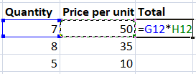
Formulas
Auto-filling formulas
Formulas can also be copied to adjacent cells with the fill handle, which can save a lot of time and effort if one needs to perform the same calculation multiple times in a worksheet. In the following example the total column displays the total for each line using the formula Quantity * Price per Unit.
One can repeat this process for the remaining lines but manually filling the formula becomes very tedious as the number of lines increases.

Slide 13
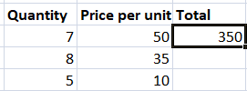
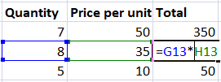
Formulas
The solution to this problem is to use the Autofill feature of Calc. Place the mouse cursor on the bottom left corner of the formula cell. When the fill handle appears drag the mouse to fill the adjacent cells with the formula.
The formulas are now filled with the correct cell references.

Slide 14
Functions

Slide 15
Functions
What are functions?
Using simple formulas for calculations, like for example the sum of a range of cells, can be tedious and complicated. In the example below we calculate the sum of the prices using a simple formula.
But if we had 20 products instead of just 3, the typing of the formula would take much more time and we probably would make mistakes. For calculations and other operations that are frequently used, Calc offers functions.

Slide 16
Functions
A function is a predefined calculation entered in a cell to help you analyze or manipulate data in a spreadsheet. Functions help one create the formulas needed to get the results that you are looking for.
Calc includes over 500 functions to help one analyze and reference data. Functions can be used with numbers, dates and times or even text.
The name of a function is an abbreviated description of what the function does

Slide 17
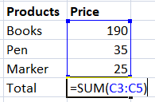
Functions
The SUM function is being used in the below example to calculate sum of products. This function takes as an argument a range of cells and calculates the sum of all cells.
Fortunately, Calc has an entire library of functions you can take advantage of. It offers common functions like Sum, Average, Product, and Count, and few advanced functions for calculating financial rates and analyzing statistics.

Slide 18
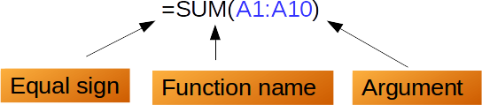
Functions
Function Syntax
use functions correctly, one needs to understand the different parts of a function and how to enter the function arguments. Each function has a specific syntax, which must be followed in order for the function to work correctly. The basic syntax to create a formula with a function is:
Insert an equals sign (=),
Insert the function name (SUM, for example is the function name for addition),
A function normally accepts one or more arguments. Arguments contain the data on which the function will calculate the result. In most cases, the arguments are references to cell areas or individual cells.

Slide 19
Functions
Arguments in functions
Arguments must be enclosed in parentheses. Multiple arguments within parentheses are separated with a semicolon (;).
Example 1
The formula = AVERAGE(B1:B8) will calculate the average of the numbers in the cell range B1 to B8. The argument in thus case is the cell range B1:B8.
Example 2
The formula = SUM(A6:A10; B1:B3; D20) will calculate the sum of all cells in ranges A6:A10, B1:B3 and the individual cell D20. Therefore, in this case the SUM function accepts multiple arguments.

Slide 20
Functions
Inserting functions in Calc
You can insert functions in Calc either manually or using the Function Wizard.
Insert a function manually
Select the cell where the result will appear.
Type the equals sign (=), then enter the function name (SUM, for example).
Type the cells reference for the argument or arguments. Alternatively you can select with the mouse the cells or cell range to automatically insert the arguments inside the parentheses.

Slide 21
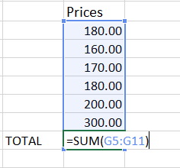

Functions
Press Enter, and the result will appear.

Slide 22
Functions
The function Wizard
The Functions Wizard is a tool that helps us first to find the function we want through the library and secondly to introduce the arguments step-by-step and with the correct syntax.
1. Select the cell that will contain the formula and the result will appear.
2. Click the fx button on the Formula bar to open the Function Wizard.
3. Select a category of functions to shorten the list, then scroll down through the named functions and select the required one by double-clicking on it. When you select a function its description appears on the right-hand side of the dialog. Double click on the function name from the list or click Next.

Slide 23
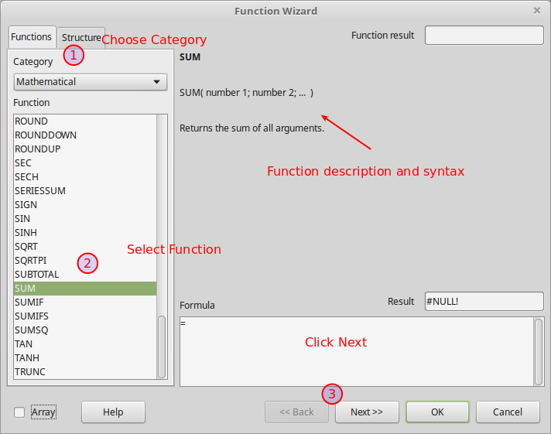
Functions
Inserting Functions

Slide 24
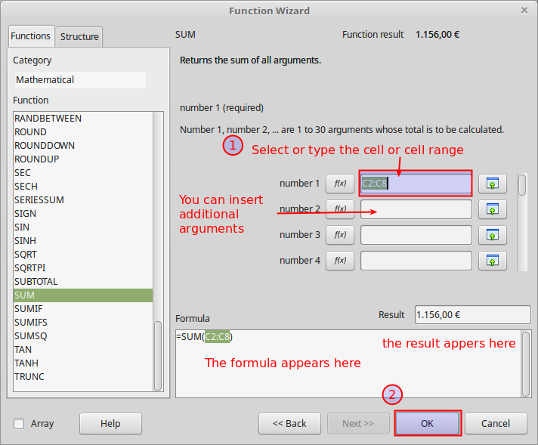
Inserting Functions
4. The Wizard now displays an area to the right where you can enter arguments manually by typing them inside the text boxes. Alternatively you can click the Shrink button to shrink the wizard so you can select cells from the spreadsheet using the mouse. Press OK to exit the wizard.

Slide 25
Basic Functions in Calc

Slide 26
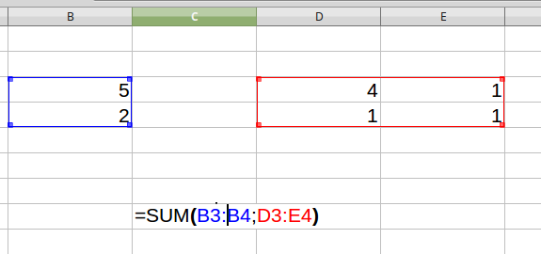
SUM
Adds all the numbers in a range of cells.
Syntax:
SUM(number1; number2;...number30)
number1 to number30 are up to 30 numbers or ranges of numbers whose sum is to be calculated.
SUM ignores any text or empty cell within a range or array.
Examples:
SUM(2; 3; 4)
returns 9, because 2+3+4 = 9.
SUM(B1:B3)
(where cells B1, B2, B3 contain 5, 4, 3) returns 12.
SUM(B3:B4; D3:E4)
returns 14

Slide 27
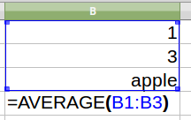
AVERAGE
Returns the average of the arguments, ignoring text.
Syntax:
AVERAGE(number1; number2; ... number30)
number1 to number30 are up to 30 numbers or ranges containing numbers.
Examples:
AVERAGE(2; 6; 4)
returns 4, the average of the three numbers in the list.
AVERAGE(B1:B3)
where cells B1, B2, B3 contain 1, 3, and apple returns 2, the average of 1 and 3.
Text is ignored.

Slide 28
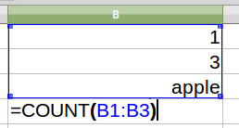
COUNT
Counts the numbers in the list of arguments, ignoring text entries.
Syntax:
COUNT(value1; value2; ... value30)
value1 to value30 are up to 30 values or ranges representing the values to be counted.
Examples:
COUNT(2; 4; 6; "eight")
returns 3, because 2, 4 and 6 are numbers ("eight" is text).
COUNT(B1:B3)
where cells B1, B2, B3 contain 1, 3, and apple returns 2.

Slide 29
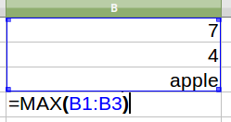
MAX
Returns the maximum of a list of arguments, ignoring text entries.
Syntax:
MAX(number1; number2; ... number30)
number1 to number30 are up to 30 numbers or ranges containing numbers.
Examples:
MAX(2; 6; 4)
returns 6, the largest value in the list.
MAX(B1:B3)
where cells B1, B2, B3 contain 7, 4, and apple returns 7

Slide 30
MIN
Returns the minimum of a list of arguments, ignoring text entries.
Syntax:
MIN(number1; number2; ... number30)
number1 to number30 are up to 30 numbers or ranges containing numbers.
Example:
MIN(2; 6; 4)
returns 2, the smallest value in the list.

Slide 31
CONCATENATE
Combines several text strings into one string.
Syntax:
CONCATENATE(text1; text2; ... text30)
Text 1; Text 2; ... represent up to 30 text passages which are to be combined into one string.
The ampersand operator & may also be used to concatenate text in a formula, without the function.
Examples:
CONCATENATE("al"; "tog"; "ether")
returns altogether.
"al" & "tog" & "ether"
also returns altogether.
CONCATENATE(A1; A2)
where cell A1 contains "key" and cell A2 contains "board" returns keyboard.

Slide 32
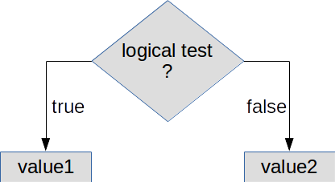
IF FUNCTION
The IF function is one of the most popular functions in Calc and other spreadsheet applications. IF performs a logical test and return one value for a TRUE result, and another for a FALSE result. In its simplest form, the IF function says:
IF(Something is True, then return value1, otherwise return value2)

Slide 33
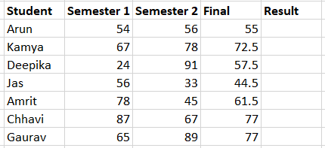
IF FUNCTION
Let's see a typical example of the IF function. A teacher uses a spreadsheet to calculate the average (final) score of his students.

Slide 34


IF FUNCTION
In the Pass/Fail column he wants to display a "Pass" text if the final score is greater or equal to 70. Using the IF function the formula is
=IF(E4>=70,"Pass","Fail")
After the function is filled the "Pass" or "Fail" result will be displayed.

Slide 35
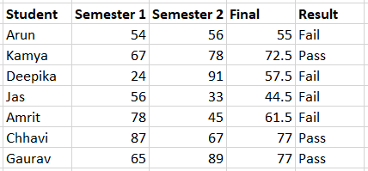
IF FUNCTION
Then you can use auto-fill to fill the remaining cells.

Slide 36
IF FUNCTION
IF Syntax
Returns one of two values, depending on a test condition.
Syntax:
IF(test; value1; value2) where:
test is or refers to a logical value or expression that returns a logical value (TRUE or FALSE).
value1 is the value that is returned by the function if test yields TRUE.
value2 is the value that is returned by the function if test yields FALSE.
If value2 is omitted it is assumed to be FALSE; if value1 is also omitted it is assumed to be TRUE.
Examples: IF(A1>5; 100; "too small")
returns the number 100 if A1 is greater than 5, and the text "too small" otherwise.
IF(1>2; "no")
returns FALSE - because value2 has been omitted and 1 is not greater than 2.
IF(2>1)
returns TRUE - because both value1 and value2 have been omitted and 2 is more than 1

Slide 37
Relative and Absolute Reference

Slide 38
Relative and Absolute Reference
References are the way that we refer to the location of a particular cell in Calc. There are two types of cell references: relative and absolute. Relative and absolute references behave differently when copied and filled to other cells or when using the autofill feature of Calc.
Relative references change when a formula is copied to another cell.
Absolute references remain constant no matter where they are copied.

Slide 39
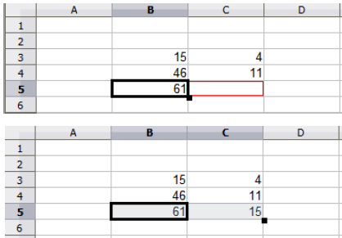
Relative references
By default, all cell references are relative references. When copied across multiple cells, they change based on the relative position of rows and columns.
For ex, if you copy the formula =A1+B1 from row 1 to row 2, the formula will become =A2+B2. Relative references are especially convenient whenever you need to repeat the same calculation across multiple rows or columns.

Slide 40
Absolute references
Sometimes when you don't want a cell reference to change when copied to other cells. Unlike relative references, absolute references do not change when copied or filled. You can use an absolute reference to keep a row and/or column constant. For ex You may want to multiply a column of numbers by a fixed amount.
To create an absolute reference in a formula we add the dollar sign ($) before the column reference, the row reference, or both.
$A$2 | the column and the row do not change when copied
A$2 | the row does not change
$A2 | the column does not change

Slide 41
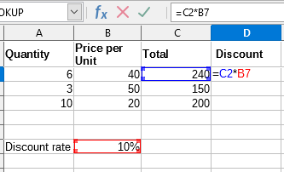
Absolute references
Let's see an example to better demonstrate the concept of absolute references. The spreadsheet shown in the image calculates the discount using the formula
Discount = Total * Discount Rate = C2 * B7

Slide 42
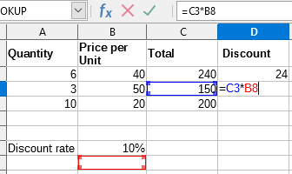
Absolute references
If we use autofill to calculate the discount for the remaining items, then we see that on the second line the reference for the Discount Rate becomes B8. This leads to error in our formula because we want the Discount Rate cell C8 to remain constant.
Because of Relative reference B7 cell changed to B8 when auto filled

Slide 43
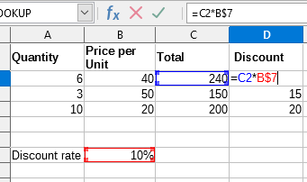
Absolute references
Now, we change the discount calculation formula to use absolute reference B$7 for the discount rate cell. In this way we get the correct results when we update with autofill the remaining cells.
In above example we used absolute reference for the row number (B$7). Alternatively we could use the full absolute reference using $B$7. In this case we autofill vertically and the column name does not change, therefore it's not necessary to use absolute reference for the column name.

Slide 44
Database Functions

Slide 45
Database Functions
Database category functions are intended to help you analyze a simple database that occupies a rectangular spreadsheet area comprising columns and rows, with the data organized as one row for each record. The header cell of each column displays the name of the column and that name usually reflects the contents of each cell in that column.
Note: The Database category may be confused with a database integrated in LibreOffice. However, there is no connection between a database in LibreOffice and the Database category in LibreOffice Calc.

Slide 46
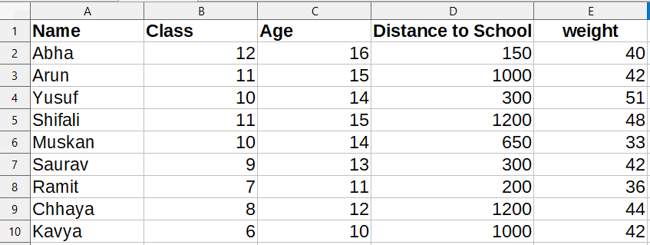
Database Functions
Example Data:
The following data will be used in some of the function description examples:
The range A1:E10 lists the students invited to a party. The following information is given for each entry: column A shows the name, B the Class, then age in years, distance to school in meters and weight in kilograms.

Slide 47
Database Function Parameters:
The following items are the parameter definitions for all database functions:
Database is the cell range defining the database.
DatabaseField specifies the column where the function operates on after the search criteria of the first parameter is applied and the data rows are selected. It is not related to the search criteria itself. For the DatabaseField parameter you can enter a reference to a header cell or a number to specify the column within the Database area, starting with 1. To reference a column by means of the literal column header name, place quotation marks around the header name.
SearchCriteria is the cell range containing search criteria. If you write several criteria in one row they are connected by AND. If you write the criteria in different rows they are connected by OR. Empty cells in the search criteria range will be ignored.
Choose Tools - Options - LibreOffice Calc - Calculate to define how LibreOffice Calc acts when searching for identical entries.

Slide 48
DSUM
DSUM returns the total of all cells in a database field in all rows (records) that match the specified search criteria.
The search supports regular expressions. You can enter "all.*", for example to find the first location of "all" followed by any characters. If you want to search for a text that is also a regular expression, you must precede every character with a "\" character. You can switch the automatic evaluation of regular expression on and off in - LibreOffice Calc - Calculate.

Slide 49
Syntax of DSUM
DSUM(Database; DatabaseField; SearchCriteria)
For the DatabaseField parameter you can enter a reference to a header cell or a number to specify the column within the Database area, starting with 1. To reference a column by means of the literal column header name, place quotation marks around the header name.
Example
To find the length of the combined distance to school of all students at party who are in 9th class, enter the following formula in B16:
=DSUM(A1:E10;"Distance to School";A13:E14)
Enter 9 in row 14 under Class. The sum of the distances to school of all the students who are in 9th class is displayed.

Slide 50
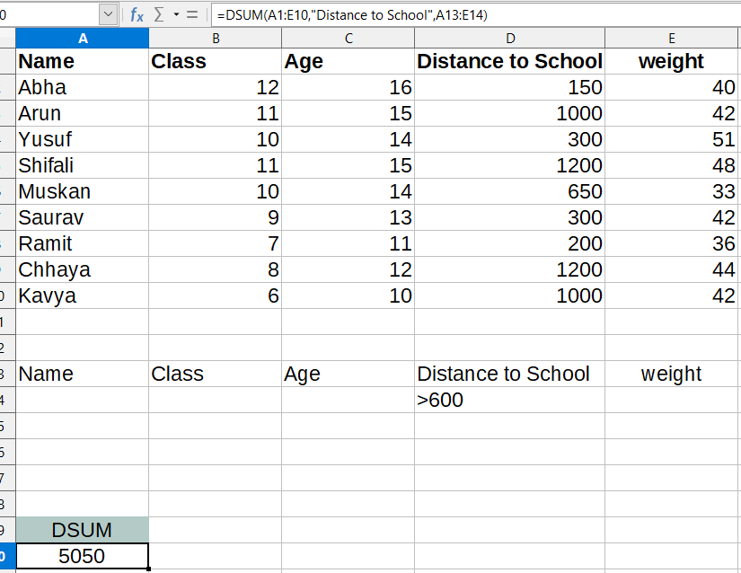
DMAX
DMAX returns the maximum content of a cell (field) in a database (all records) that matches the specified search conditions.
The search supports regular expressions. You can enter "all.*", for example to find the first location of "all" followed by any characters. If you want to search for a text that is also a regular expression, you must precede every character with a "\" character. You can switch the automatic evaluation of regular expression on and off in - LibreOffice Calc - Calculate.

Slide 51
Syntax of DMAX
DMAX(Database; DatabaseField; SearchCriteria)
For the DatabaseField parameter you can enter a reference to a header cell or a number to specify the column within the Database area, starting with 1. To reference a column by means of the literal column header name, place quotation marks around the header name.
Example
To find out how much the heaviest child in each class weighed in the example, enter the following formula in B16:
=DMAX(A1:E10;"Weight";A13:E14)
Under class, enter 12,11,10 and so on, one after the other. After entering a class, the weight of the heaviest child in that class appears.

Slide 52
DMIN
DMIN returns the minimum content of a cell (field) in a database that matches the specified search criteria.
The search supports regular expressions. You can enter "all.*", for example to find the first location of "all" followed by any characters. If you want to search for a text that is also a regular expression, you must precede every character with a "\" character. You can switch the automatic evaluation of regular expression on and off in - LibreOffice Calc - Calculate.

Slide 53
Syntax of DMIN
DMIN(Database; DatabaseField; SearchCriteria)
For the DatabaseField parameter you can enter a reference to a header cell or a number to specify the column within the Database area, starting with 1. To reference a column by means of the literal column header name, place quotation marks around the header name.
Example
To find the shortest distance to school for the children in each class in the above example, enter the following formula in B16:
=DMIN(A1:E10;"Distance to School";A13:E14)
In row 14, under class, enter 12, 11, 10 and so on, one after the other. The shortest distance to school for each class appears.

Slide 54
DCOUNT
DCOUNT counts the number of rows (records) in a database that match the specified search criteria and contain numerical values in the DatabaseField column.
The search supports regular expressions. You can enter "all.*", for example to find the first location of "all" followed by any characters. If you want to search for a text that is also a regular expression, you must precede every character with a "\" character. You can switch the automatic evaluation of regular expression on and off in - LibreOffice Calc - Calculate.

Slide 55
Syntax of DCOUNT
DCOUNT(Database; [DatabaseField]; SearchCriteria)
If the DatabaseField argument is omitted, DCOUNT returns the count of all records that satisfy Criteria. For the DatabaseField parameter you can enter a reference to a header cell or a number to specify the column within the Database area, starting with 1. To reference a column by means of the literal column header name, place quotation marks around the header name.
Example
In the example above, if you want to know how many children have to travel more than 600 meters to school. The result is to be stored in cell B16. Set the cursor in cell B16. Enter the formula =DCOUNT(A1:E10;D1;A13:E14) in B16. The Function Wizard helps you to input ranges.

Slide 56
Syntax of DCOUNT
Database is the range of data to be evaluated, including its headers: in this case A1:E10. DatabaseField specifies the column for the search criteria: in this case, the column with the numerical distance values. SearchCriteria is the range where you can enter the search parameters: in this case, A13:E14.
To know how many children in 9th class are over 12 years of age, delete the entry >600 in cell D14 and enter 9 in cell B14 under class, and enter >12 in cell C14 to the right. As both criteria are in the same row, they are connected by AND.

Slide 57
DCOUNTA
DCOUNTA counts the number of rows (records) in a database that match the specified search conditions, and contain numeric or alphanumeric values.
The search supports regular expressions. You can enter "all.*", for example to find the first location of "all" followed by any characters. If you want to search for a text that is also a regular expression, you must precede every character with a "\" character. You can switch the automatic evaluation of regular expression on and off in - LibreOffice Calc - Calculate.

Slide 58
Syntax of DCOUNTA
DCOUNTA(Database; [DatabaseField]; SearchCriteria)
If the DatabaseField argument is omitted, DCOUNTA returns the count of all records that satisfy Criteria. For the DatabaseField parameter you can enter a reference to a header cell or a number to specify the column within the Database area, starting with 1. To reference a column by means of the literal column header name, place quotation marks around the header name.
Example
In the example above, you can search for the number of children whose name starts with an A or a subsequent letter. Edit the formula in B16 to read
=DCOUNTA(A1:E10;"Name";A13:E14).
Delete the old search criteria and enter >=A under Name in field A14. Note that the DatabaseField parameter must point to a column that can contain values.

Slide 59
Charts

Slide 60
Charts : Introduction
A chart or a graph is simply a visualization of spreadsheet data. A chart can create a clear picture of a set of data and allow users to better understand the results and see patterns inside the data.
Charts can be powerful tools for conveying information and spreadsheet programs offers a variety of ways to present data.

Slide 61

Basic types of charts
In order to use charts effectively, you'll need to understand how different charts are used. The type of chart you choose depends on the type of data and the way you want it to be presented.
Column Chart
The column chart is suitable for viewing changes in data over a period of time and comparing them. In the diagrams, data series are usually organized along the horizontal X axis and the values along the vertical Y axis.

Slide 62
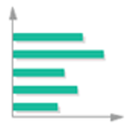
Basic types of charts
Bar Chart
Displays values for one or more series using horizontal columns. In a bar chart, the categories are typically organized along the vertical axis, and the values along the horizontal axis.

Slide 63

Basic types of charts
Pie chart
Pi charts make it easy to compare proportions. Each value is shown as a slice of the pie, so it's easy to see which values make up the percentage of a whole.

Slide 64
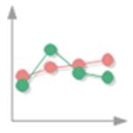
Basic types of charts
Line Chart
Displays values as equally spaced points connected with a line. This chart is most useful displaying trends over time or other ordered category for single or multiple data series.

Slide 65
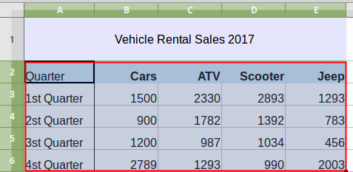
Creating a chart
To create a chart:
1. Select the data to be included in the chart, include row and column headings but not the title for the data table.

Slide 66
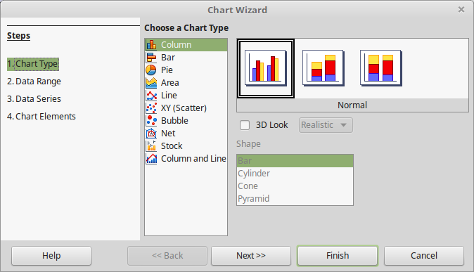
Creating a chart
2. Now the Chart Wizard opens. In the first step select the Chart Type and optionally change some options specific to each chart type. For example for the Column chart you can change to a 3D look.

Slide 67
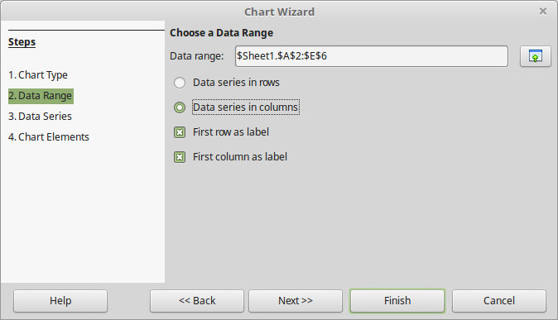
Creating a chart
3. In this step , the wizard recognizes the Data Range of your chart. Leave the default values.

Slide 68
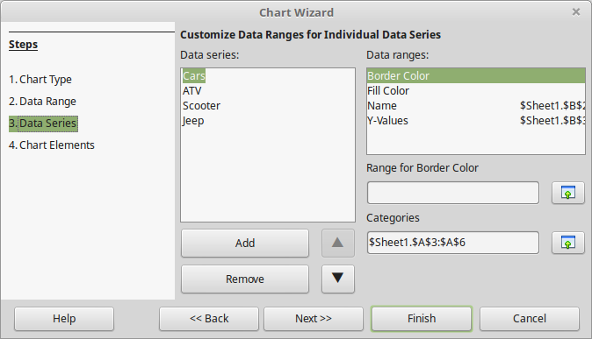
Creating a chart
4. Each Data Series represents a column of the data. In our example there are four data series. In this step one can reorder, add or remove data series.

Slide 69
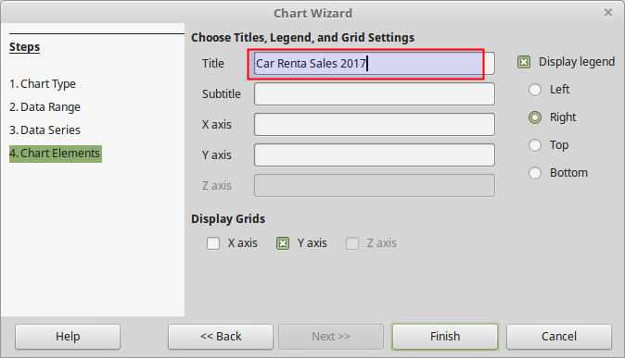
Creating a chart
5. In the last step one can set labels for the Title, Subtitle and for each axis. One can also disable or change the position of the chart legend.

Slide 70
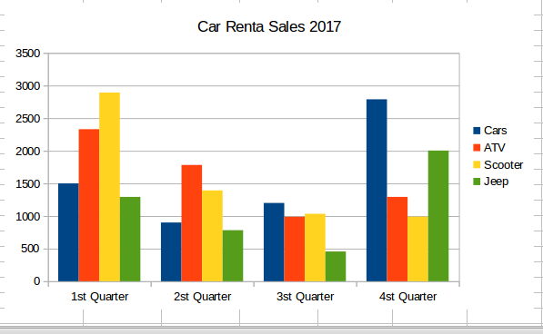
Creating a chart
When the wizard finishes the chart is inserted inside the spreadsheet as an object. Note that a chart is a dynamic object which means it is updated whenever the source data change.

Slide 71
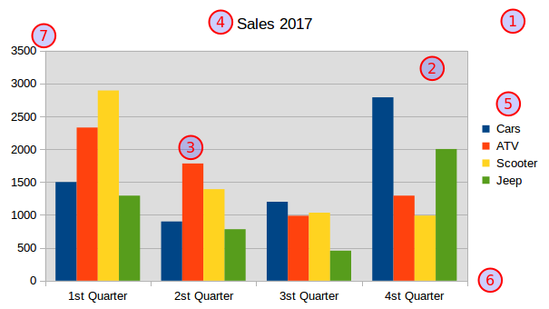
Chart elements
A chart inserted into a sheet behaves both as graphic object and as chart object. When one clicks into chart you can resize and position the object. Before learning to edit chart one must become familiar with the chart elements or parts.

Slide 72
Chart elements
Chart area. The area surrounding the entire object of the chart. It includes the chart wall and all other parts.
Chart wall. The area enclosed by the two axes where the actual chart is drawn.
Data series. A set of related values, representing a row or column of data. A chart can only have one or more data series.
Title. A label useful for setting the title for the diagram.
Legend. The legend shows which data series each color on the chart represents.
Axis. In the two-dimensional diagrams, there are two axes - the horizontal axis X and the vertical Y axis

Slide 73
Editing charts
Spreadsheet programmes provides tools for changing the chart type, chart elements, data ranges, fonts, colors, and many other options. To change chart properties you must first double click inside a graph to enter chart edit mode. In this case the chart toolbar appears on the Calc window.

Slide 74
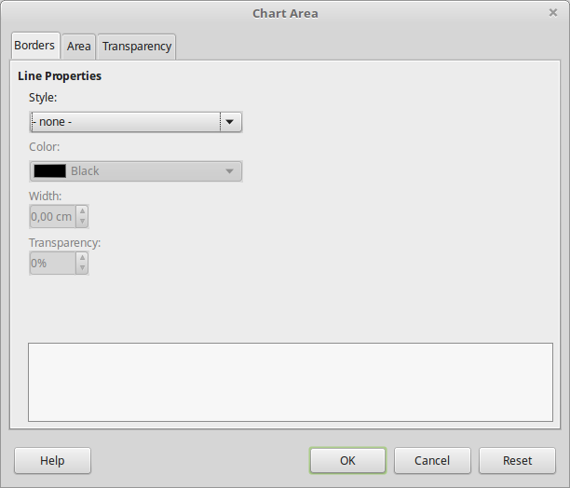
Editing charts
Formatting chart parts
To format a chart part select the part from the drop-down menu and click the Format Selection button. The formatting window opens where you can change borders, area and transparency options. The example below shows the formatting window of the Chart Area element. Alternatively you can use the Sidebar to format a selected chart element.

Slide 75
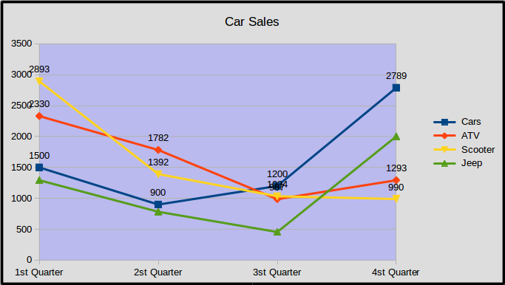
Editing charts
One can also format the Chart area and Chart wall with the button present on chart toolbar. In the example below the chart wall has different color then the chart area.

Slide 76
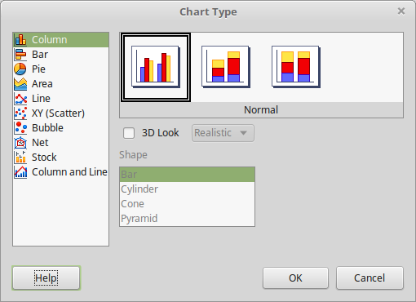
Editing charts
Changing chart type
One can change the chart type any time by clicking the Chart Type button on the toolbar. Set the new chart type in Chart Type window.

Slide 77
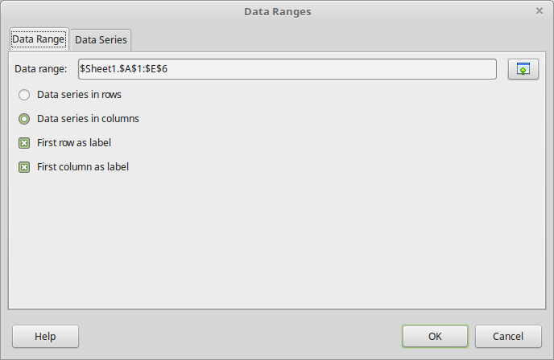
Editing charts
Data Ranges
A chart draws data from a range of cells in a spreadsheet. Click the Data Ranges button to open the Data Ranges window. Data in a chart are divided in data series. By default a series represents a column in your data. However you can change this option to Data series in rows.

Slide 78
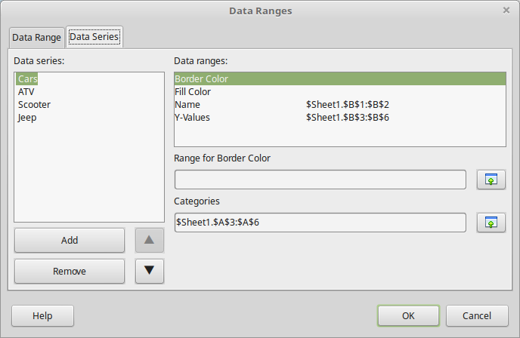
Editing charts
In the Data Series tab you can change the order, add or remove data series.

Slide 79
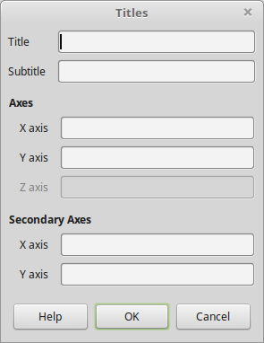
Editing charts
Titles
One can put text in some parts of a chart. Click the Titles button to bring the Titles window. In this window you can enter a Title and Subtitle for the chart and text labels for both axes.

Slide 80
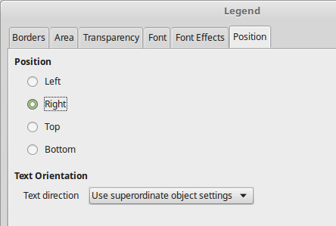
Editing charts
Legend
The legend shows which data series each color on the chart represents. To display or hide the Legend click the Legend button. To format the Legend and change the position click the Format Legend button.

Slide 81
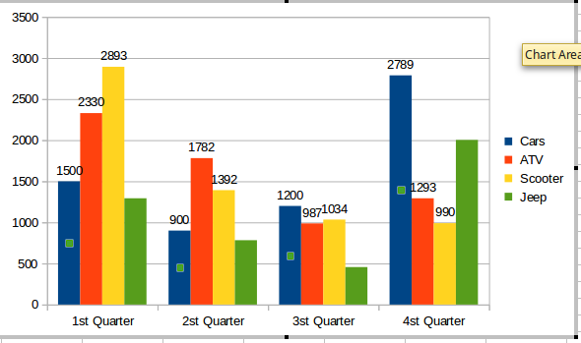
Editing charts
Data Labels
Data labels display the data value for a data series in a chart. To insert Data Labels right click on a data series and choose the Insert Data Labels command. Repeat this process for all data series.

Slide 82
Exporting chart as image
Exporting as Image
One can export a chart as a png image in order to use it to another application. To export a chart as an image simply
Make sure one is not in chart edit mode
Right click on the chart
Select the Export as Image
Set a name and location for the image file.

